Slide 1
1047
Incoming Inspection Report
11/06/2023
Juarez Chihuahua.

Slide 2
Index
Tool General Information Identification Plaques.
Injection layout – Hot Runner System ,Plaques, tests .
Layout Cavity Side (Main appearances ).
Slides , Retractors , Lifters Details.
Layout Core Side (Main appearances ) .
Ejector System & Parts .
Locating Ring.
Electrical Plugs .
Water Leaks Test.
Spare Parts , Documents ,Tool manuals etc. Received .
Observations / Summary.
Quick Check List.

Slide 3
Tool General Information Identification Plaques
01

Slide 4
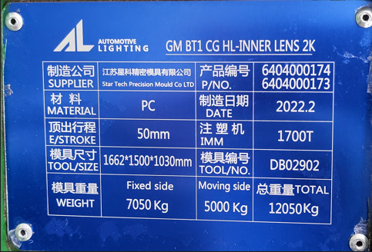
Tool Identification plate
✓
Tool Identification | Description
Owner of Tool: | GM
Tool Source: | STAR TECH
Job: | ALNA 1047
Part Number: | 6404000174 / 6404000173
ASSET# | N/A
ALNA Number: | ALNA 1047

Slide 5
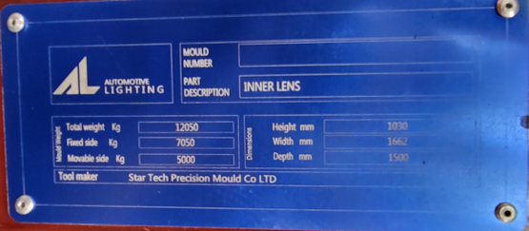
Tool Identification plate
✓
Tool Description
mold weight: | 12,050
,mold size (axbxc): | 1030mm x 1662mm x 1500mm
Texture Type: | No
Core Steel Type: | N/A
Cavity Steel Type: | N/A
Sprue Radius: | N/A
Orifice Size: | N/A

Slide 6
Injection layout – Hot Runner System ,Plaques, tests .
02

Slide 7
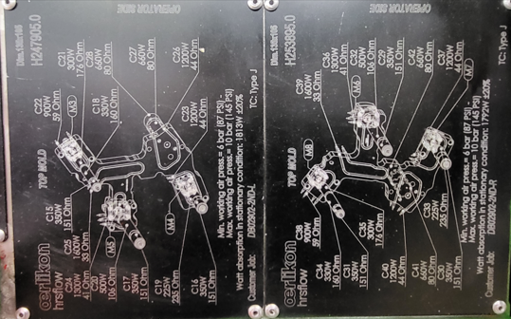
Hot Runner System
✓
Zone Hot Nozzle system:
# Zones 42
Hot Runner System OERLIKON #H247905.0

Slide 8
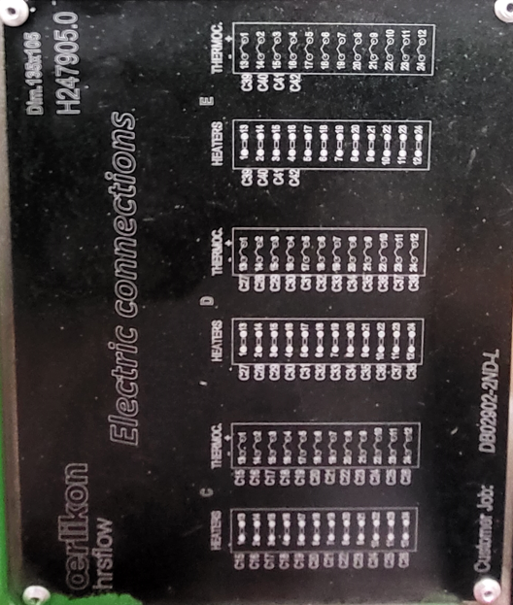
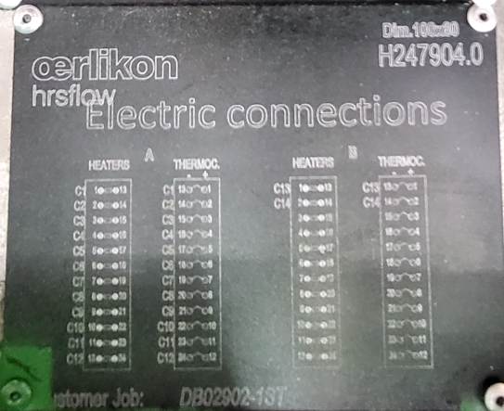
Hot Runner System
✓
Zone Hot Nozzle system:
# Zones 42
Hot Runner System OERLIKON #H247905.0

Slide 9
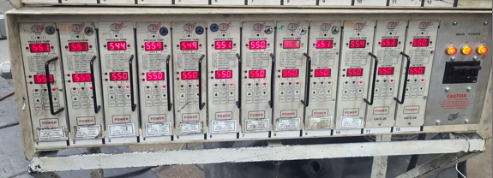
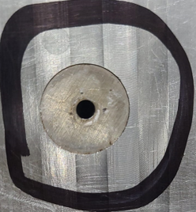
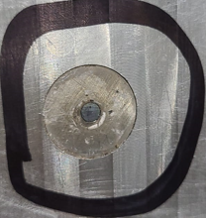
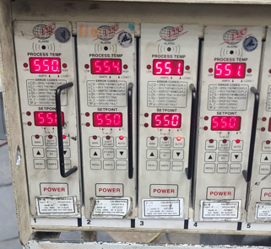
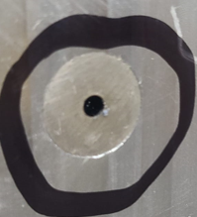
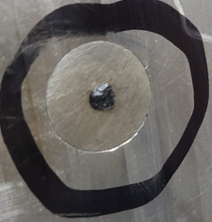
Hot Runner System Testing
✓
Valve #1open
Valve #1 Closed
Valve #2 open
Valve # 2 Closed
Heaters tested at 550 ° C, valve pin movement is performed, ok they open and close correctly.
Testing the hot runner system comments:

Slide 10
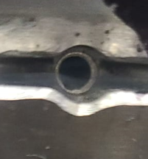
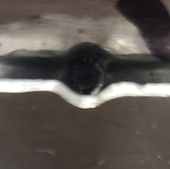
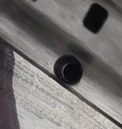
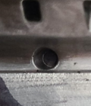
Hot Runner System Testing
✓
Valve #1open
Valve #1 Closed
Valve #2 open
Valve # 2 Closed
Heaters tested at 550 ° C, valve pin movement is performed, ok they open and close correctly.
Testing the hot runner system comments:

Slide 11
Layout Cavity Side (Main appearances )
03

Slide 12
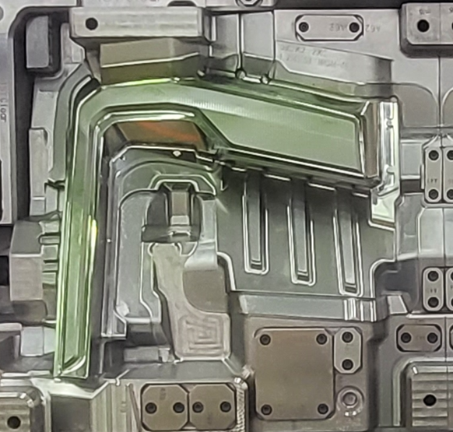
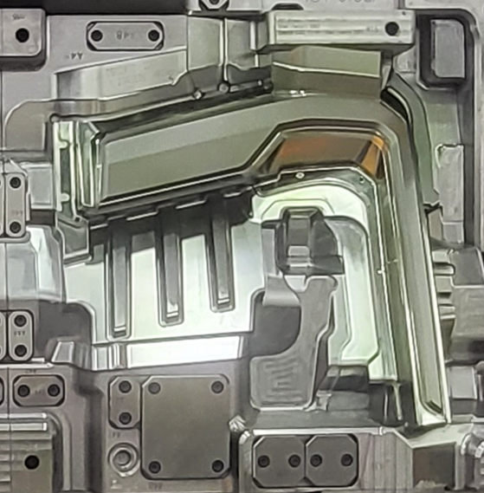
Lay outs – Mobile Side
Sectional views:
✓
Cavidad 1
Cavidad 2

Slide 13
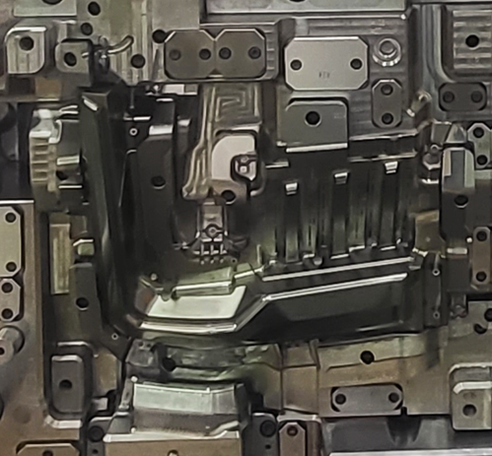
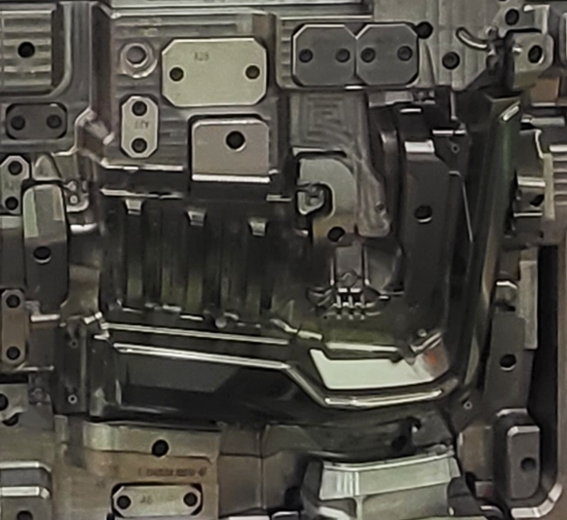
Lay outs – Mobile Side
Sectional views:
✓
Cavidad 3
Cavidad 4

Slide 14
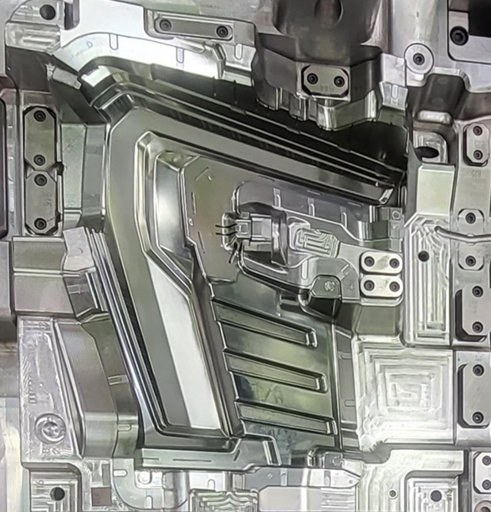
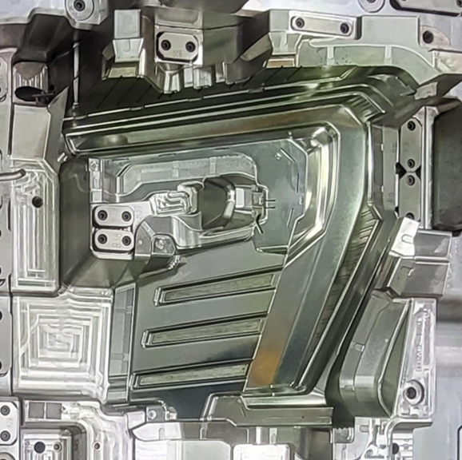
Lay outs – Fixed Side
Sectional views:
✓
Cavidad 1
Cavidad 2

Slide 15
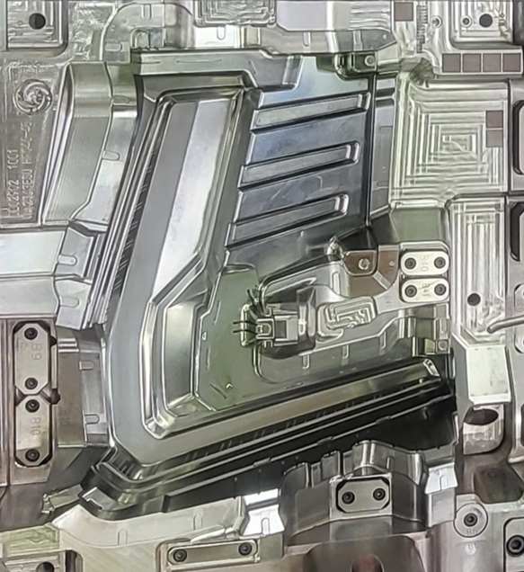
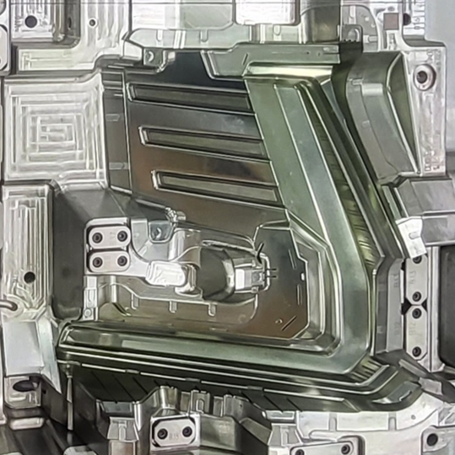
Lay outs – Fixed Side
Sectional views:
✓
Cavidad 3
Cavidad 4

Slide 16
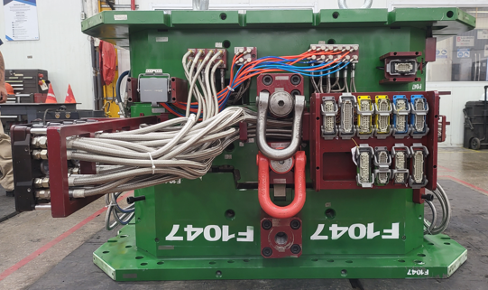
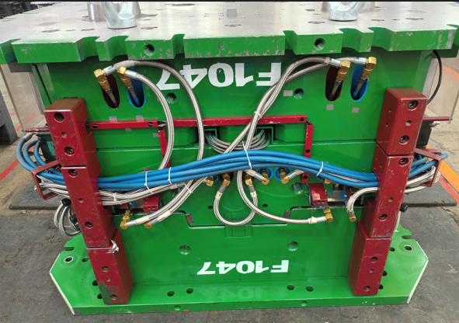
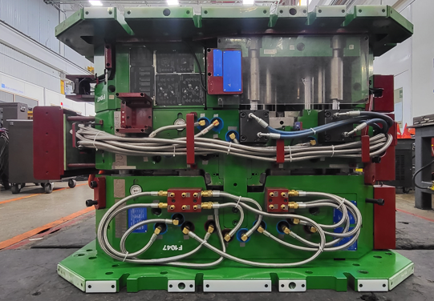
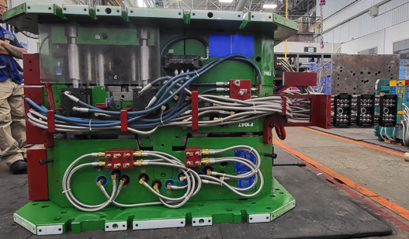
Tool View
✓
Top Side
Bottom Side
Non Operator Side
Operator Side

Slide 17
Slides , Retractors , Lifters Details.
04

Slide 18
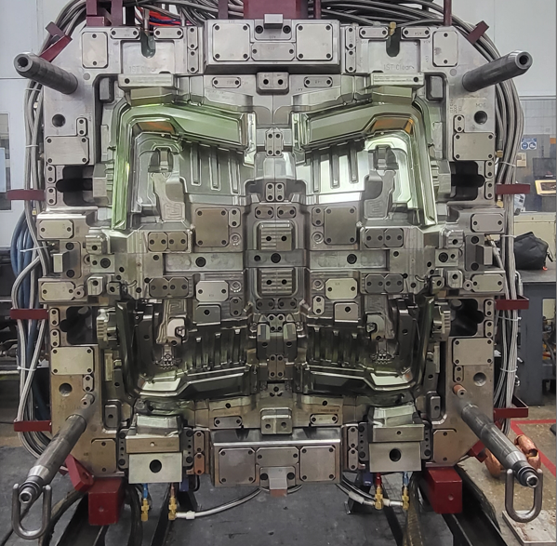
Lay outs – Fixed Side
✓
Mold Cavity- how many cavity 2
Identification of Mechanisms by Colors
Sliders
Lifters
Recuperators
Leader Pin
Angle pin
Spotting Plaques

Slide 19
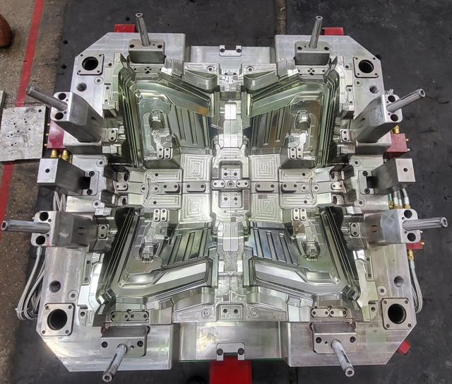
Lay outs – Mobile Side
Mold Cavity- how many cavity 2
✓
Identification of Mechanisms by Colors
Sliders
Lifters
Recuperators
Leader Pin
Greasers
Spotting Plaques

Slide 20
Slides, Retractors , Lifters etc.
✓
Mold Have The Following Systems.
Components | Lifters | Recuperators | Sliders | Ejector Sleeves | Ejector Blades | Ejector Pins | Others
Quantity | 12 | 4 | 2 | N/A | 0 | n/a
Damages | NO | NO | N/A | N/A | N/A | NO
Water Cooling? | NO | NO | N/A | N/A | N/A | N/A
Plugs: Press Fit Or Threaded | N/A | N/A | N/A | N/A | N/A | N/A
Water Leaks | N0 | N/A | N/A | N/A | N/A | N/A
Water Connectors Size | NO | N/A | N/A | N/A | N/A | N/A
Welding Marks | NO | NO | N/A | N/A | N/A | NO
Movements | YES | NO | YES | N/A | N/A | N/A
Fastening With Screws Or Bolts | NO | N/A | N/A | N/A | N/A | N/A
Stopper | N0 | N/A | N/A | N/A | N/A | N/A
CAM PIN Position | N/A | N/A | N/A | N/A | N/A | N/A
Slide Retainer | N/A | N/A | N/A | N/A | N/A | N/A
ALNA Standard? | YES | N/A | N/A | N/A | N/A | N/A
Additional Comments:

Slide 21
Layout Core Side (Main appearances )
05

Slide 22
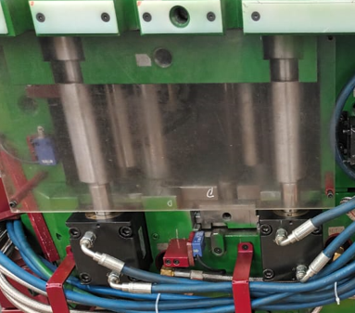
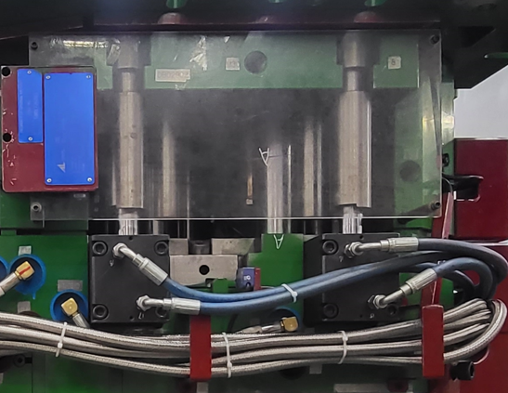
Layout Core Side (main appearences)
✓

Slide 23
Ejector System & Parts .
05

Slide 24
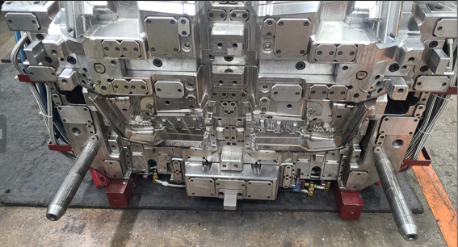
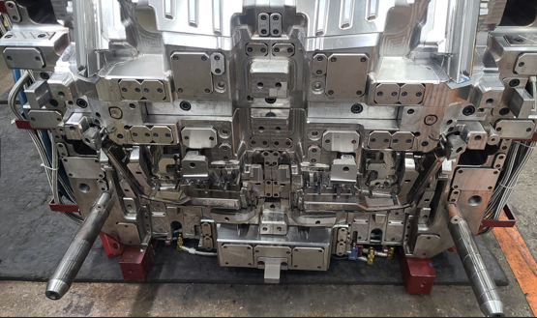
Ejector System
✓
First position: Slides & retractors in Position backward
Second position: Slides & retractors in Position forward ( ejection backward)

Slide 25
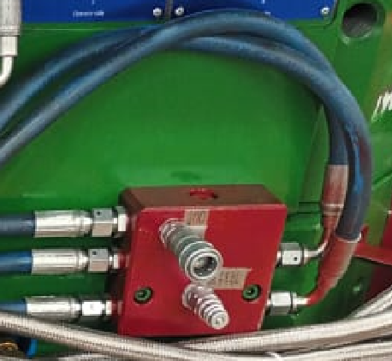
Ejector System
✓
Ejection System Has The Following Configuration:
hydraulic ejection system
blow ejection system
1050mm

Slide 26
Ejector System Parts
No se sacaron expulsores

Slide 27
Locating Ring.
06

Slide 28
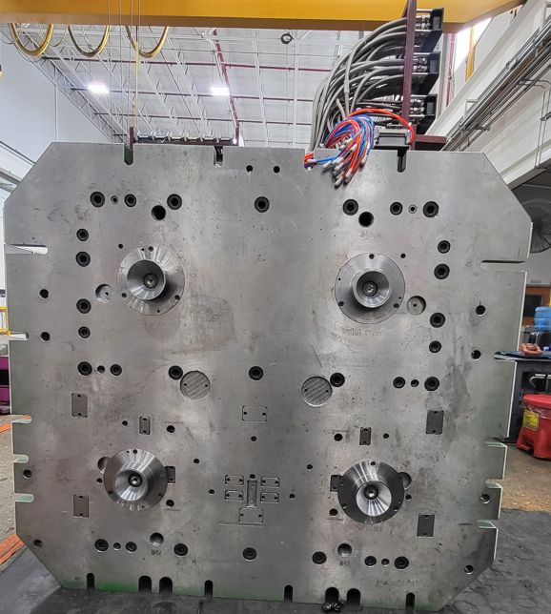
Locator Ring
✓
Fixed Side

Slide 29
Electrical Plugs .
07

Slide 30
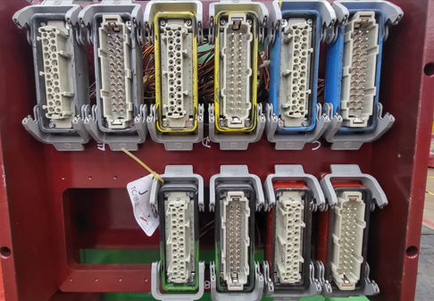
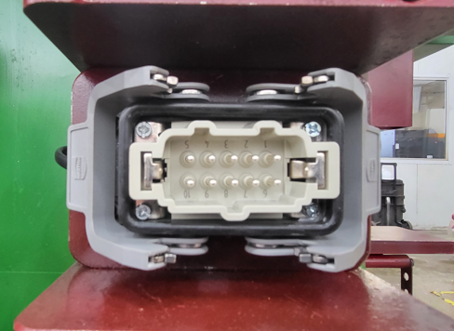
Electrical Parts
✓
Conector Plug for HotRunner System.
Connector standard D-M-E per Heater and Thermocouples
42 for heater and 42 for thermocouples
Connector standard for limit switch D-M-E
Heaters & Thermocouple.
Limit Switch Connector

Slide 31
Water Leaks Test
08

Slide 32
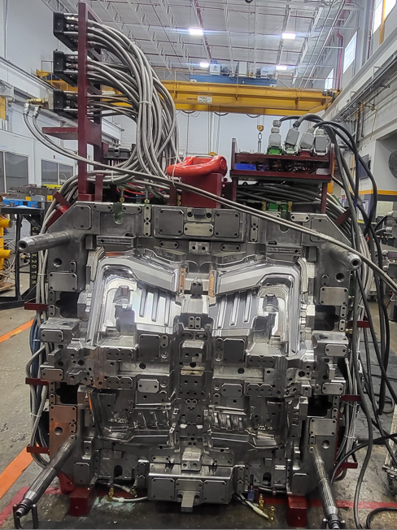
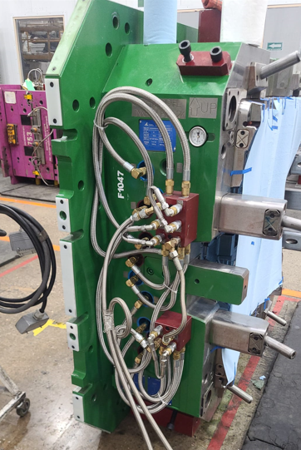
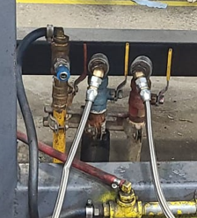
Water Leak Testing
✓
Mobile side
Fixed side
Cooling tests are performed, result ok without water leaks.

Slide 33
Spare Parts , Documents ,Tool manuals etc. Received .
09

Slide 34
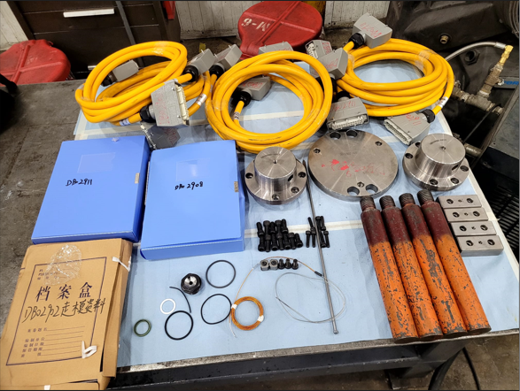
1 | Folder
1 | Usb
1 | Hot System
3 | Centering ring
4 | Cables for controller
Spare Parts, Documents, Tool Manual Received.

Slide 35
Observations / Summary.
10

Slide 36
Observations
The Ejector System Is Working. Okay
The Hot System Works Ok
Mirror Areas Okay
Alna Estándar Okay
Coolingsystem core side / cavity side Ok
Texture área: Okay

Slide 37
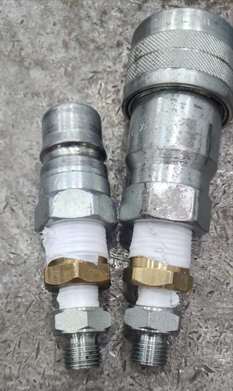
Observations
✓
Hydraulic system connectors are changed
Ejector System

Slide 38
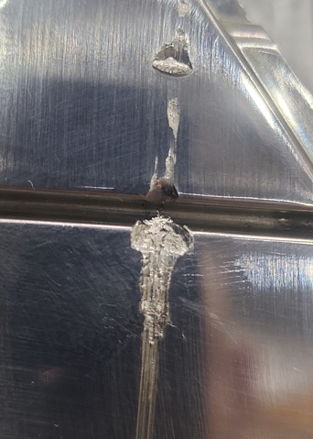
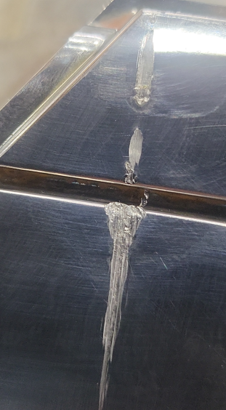
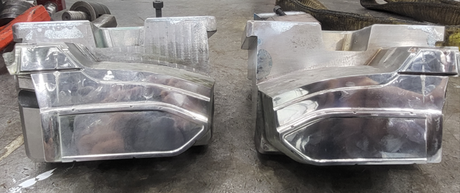
Observations
✓
The ejection system is located in the fixed part of the mold. The mold was received with the fixed part up, when opening the mold we realized that the ejector plate was in the front (ejectors and lifters out of position) which cause the sliders to collide with the ejector
Damaged sliders

Slide 39
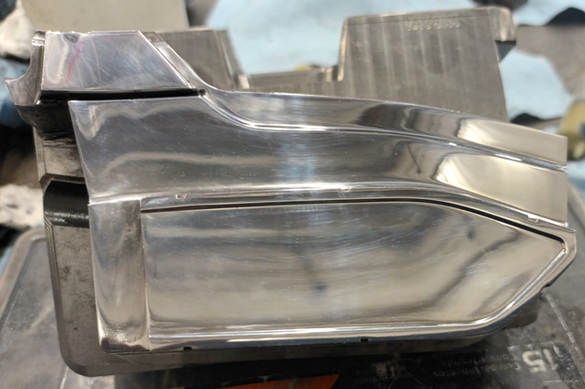
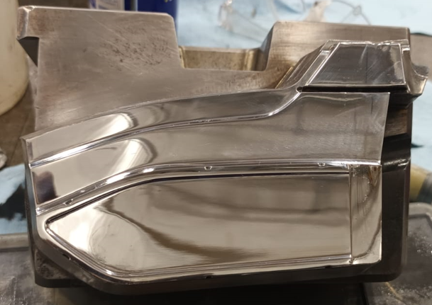
Observations
✓
Damaged sliders are repaired
Repaired sliders

Slide 40
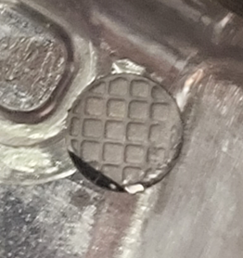
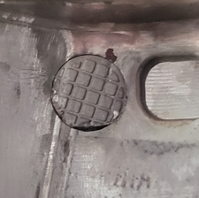
Observations
✓
Ejectors damaged by Lifters
Damaged ejector

Slide 41
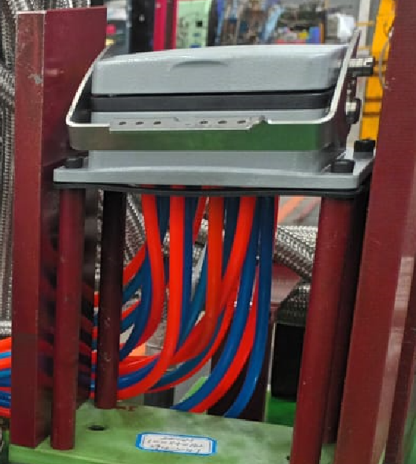

Observations
✓
Connectors from M6 to M8 are placed
Change of Staubli

Slide 42
Quick Check List.
11

Slide 43
Quick Checklist
L# | DESCRIPTION | YES | NO | N/A | COMMENTS / OBSERVATIONS
1 | LOCATING RINGS | x
2 | AIR VENTS & ITS DEPTH | x
3 | INTERLOCKS ( PARTING LINE LOCKS ) |  | x
4 | DATE INSERTS OR ENGRAVING | x
5 | HOT RUNNER SYSTEMS NUMBER | x |  |  | H247905.0
6 | THERMOCOUPLE & RESISTANCE SPARES | x
7 | EJECTOR BLADES |  | X
8 | VALVE GATES AVAILABILITY | x
9 | ANGLE PINS FOR SLIDES | x
10 | LOCKING CYLINDERS AVAILABILITY |  | X
11 | SPRINGS ON EJECTION SYSTEM | X
12 | TEXTURES IN CAVITY | x
13 | IDENTIFICATION ON ALL PARTS | x
14 | HYDRAULIC PISTON FOR CORES | X
15 | LIMIT SWITCHES (MICRO SWITCH) | x
16 | RJG OR SPECIAL SENSORS |  | x
17 | SAFETY LOCK | x
18 | INSERT CHANGES SPARES |  | X
19 | MOLD DRAWINGS & CD | x

Slide 44
Quick Checklist
L# | DESCRIPTION | COMMENTS
1 | MOLD NUMBER | 1047
2 | PART NUMBER | N/A
3 | PART NAME | GM BT1CG HL (INNER LENS)
4 | NO. OF CAVITIES | 4
5 | CAVITIES MARKED NO.'S | NO
6 | TOOLING ENGINEER NAME | Protev
7 | MOLD ARRIVAL DATE | 8/06/2023
8 | MOLD INCOMING INSP. DATE START | 10/06/2023
9 | MOLD INCOMING INSP. DATE FINISH | 11/06/2023
10 | TOTAL ACCUMULATED HOURS | 26hrs
11 | INCOMING INSPECTION STATUS | FINISHED
12 | INCOMING INSPECTION PERFORMED BY | Alberto Ramirez & Lorenzo Lopez
13 | FREQUENCY FOR PM
14 | PRESS ASSIGNED

Slide 45
Thanks!

